Slide 1


K.RAMAKRISHNAN COLLEGE OF TECHNOLOGY
(AUTONOMOUS), TRICHY
PROJECT TITLE < SIZE- 36 >
PRESENTED BY
REGISTER NUMBER- NAME
Notes:
‹#›

Slide 2
PRESENTATION OVERVIEW
Problem Identification
Objective
Proposed system
Block diagram of proposed system
Data structures used
Modules
Notes:
‹#›

Slide 3
PROBLEM IDENTIFICATION
Problem identification 1
naccurate inventory management: The current system may not accurately track and update inventory levels, leading to issues such as out-of-stock items or overstocked product
naccurate inventory management: The current system may not accurately track and update inventory levels, leading to issues such as out-of-stock items or overstocked products
Problem identification 2
Problem identification 3
2/7/20

Slide 4
OBJECTIVE
Objective 1
Objective 2
Objective 3
Notes:
‹#›

Slide 5
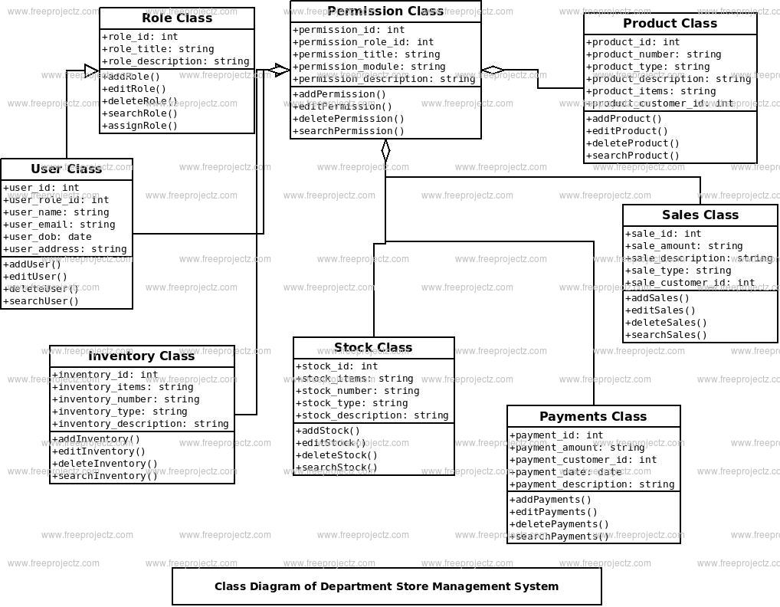
PROPOSED SYSTEM
BLOCK DIAGRAM
Notes:
‹#›

Slide 6
DATA STRUCTURES USED
Notes:
‹#›

Slide 7
ADVANTAGES OF PROPOSED SYSTEM
Notes:
‹#›

Slide 8
THANK YOU
Notes:
‹#›

